Slide 1
Static and Dynamic Websites

Slide 2
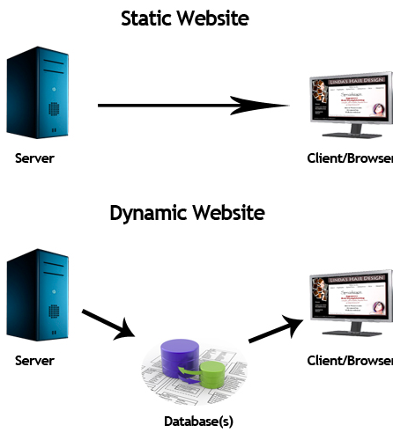
Static vs Dynamic Websites
Static sites don’t change unless the author edits the page
Wikipedia
Jen’s Kitchen
Dynamic (almost everything on the internet)
Facebook, Twitter, Google
Amazon, eBay
Pandora, Spotify, YouTube

Slide 3
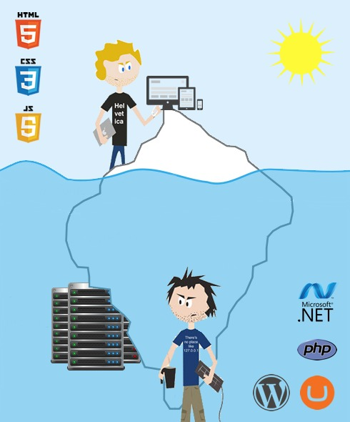
Front End Designer and Backend Developers
Front End Developer
Design a site and page layout
Create graphics
Create content
Some JavaScript code for validating forms, animating page elements
Back End Developer
Design database tables
Server-side code such as PHP, Ruby, Python, .Net and Java.

Slide 4
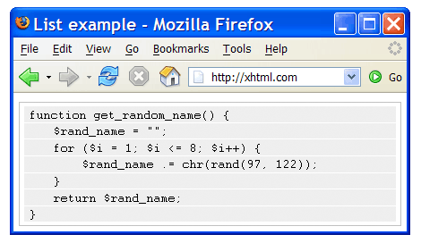
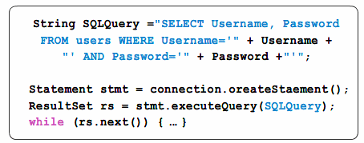
PHP and SQL code examples…

Slide 5
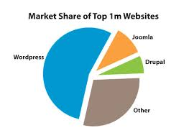

Content Management Systems (CMS)
Most of the technical programming work is already done.
“Fill in the blank” tasks such as defining categories, menus and writing content with multiple authors.
Often free – WordPress, Joomla, Drupal are the three most popular general purpose CMS packages.

Slide 6
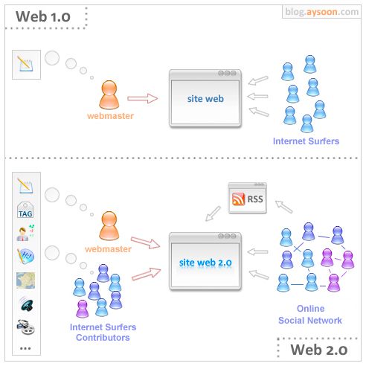
Web 1.0 is a term to describe early static websites (1990-2000)
Web 2.0 describes the use of web sites to connect and collaborate. Facebook was founded in 2004. (2000-2010)
Web 3.0 describes the ability of computers to do some artificial intelligent thinking and sorting for us. Siri and Android Now were launched in 2012 (2010-present)

Slide 7
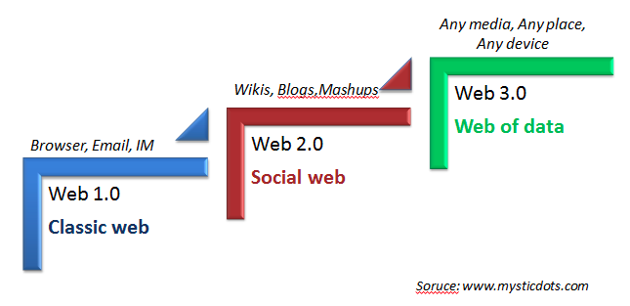

Slide 8
HTML 5
Video describing the new features of the latest version of HTML
https://www.youtube.com/watch?v=IsXEVQRaTX8

Slide 9
Way Back Machine
Let’s compare how Yahoo was designed in 1997 to how it looks today.
Go to https://archive.org This site hosts the “Way back machine”. It captures snapshots of websites and archives them like a historical document.
Type in www.yahoo.com
Compare old designs from early years to now.

Slide 10
The “Full Stack” development experience in this class
Q1 – Develop static sites using WIX, WordPress or Joomla CMS.
Q2 – Develop a static site using a HTML/CSS and Frameworks.
Q3 – Develop dynamic client pages using JavaScript.
Q4 – Develop backend databases using PHP.

